Slide 1


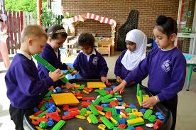
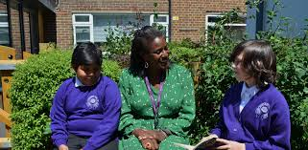
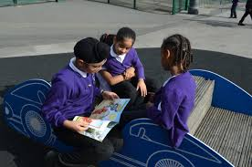
DORMERS WELLS
PRIMARY SCHOOL
Diversity- Opportunity –Resilience- Moral - Empathy- Respect –Success
Believe Aspire Flourish
Classical Music

Slide 2

DORMERS WELLS
PRIMARY SCHOOL
Head Teacher- Mrs. George
Deputy Head Teacher- Mrs. Mosley
Assistant Head Teacher (SENDCO and Inclusion) – Mrs. Sargeant
Assistant Head (Achievement)– Mr. Cotton
Family Support Worker- Mrs Cornelius
Office Manager- Ms. Doyle
Welfare and attendance- Miss. Scott
Believe Aspire Flourish

Slide 3
Believe Aspire Flourish
DORMERS WELLS
PRIMARY SCHOOL
Staff
Phase Leader Upper KS2 – Mr Cotton
Year 5 Teacher – Ms Kaler (Head of Year 5) 5B Blackman
Year 5 Teacher –Ms Ellington 5Z Zephaniah
Year 5 Teaching Associates - Mrs. Willets

Slide 4

Our School Priorities 2026- 27
Believe Aspire Flourish

Slide 5

Attendance and Medication
WHY ATTENDANCE AND PUNCTUALITY MATTERS
Across one school year:
Less than 5 days absence = 97.3% attendance
14 days absence (approx.) = 92.6% attendance.
20 days absence (approx.) = 89.4% attendance
30 days absence (approx.) = 84.2% attendance
If a child achieves 80% attendance this means that they have missed approximately 39 days of education over the academic year, averaging 1 day per week.
“Every day counts and every child matters!”
Absence for whatever reason disadvantages a child by creating gaps in his/her learning. A good understanding of the work and good progress can only take place when the child is in the classroom regularly and on time. If your child is ill, please ensure you ring the office on the morning they are absent other wise this will be an ‘unauthorised absence’.
Medication
If your child has any medication that is needed in school eg. asthma pumps, epi pens etc, please ensure it is up to date and present in school.
Believe Aspire Flourish

Slide 6
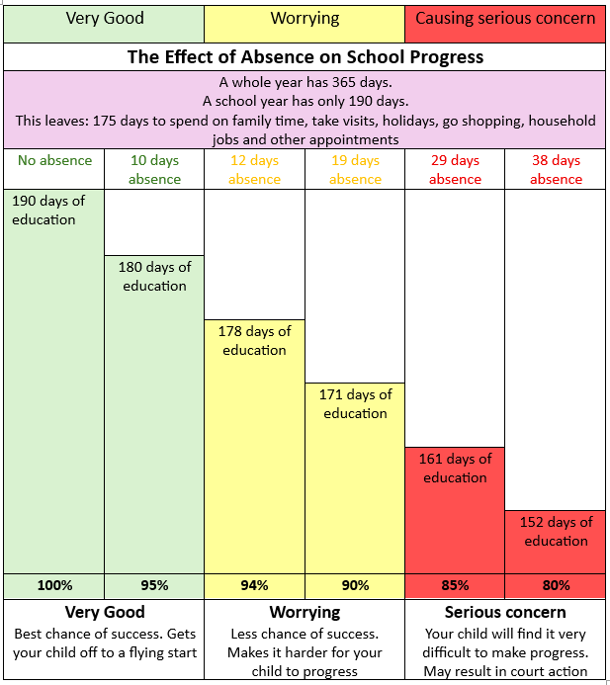
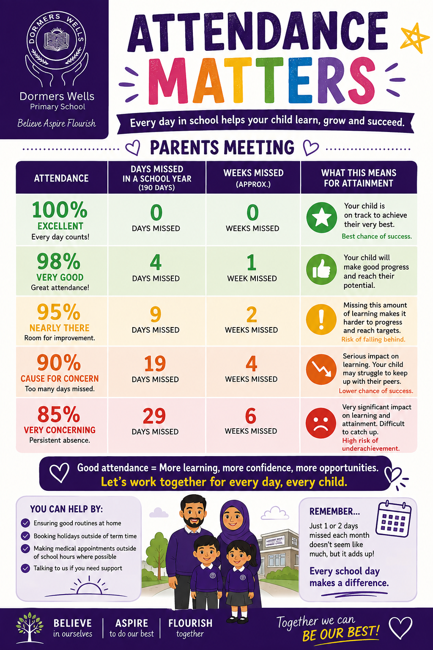
Attendance matters
Believe Aspire Flourish

Slide 7
Attendance - Holiday request.
We work within the government guidelines and with Ealing borough to monitor attendance.
We are not permitted to grant holiday leave unless in extreme circumstances and this must be agreed by the head or deputy head teacher.
Term time holidays will not be granted.
There are 13 weeks of holiday built into the school year and this is time for family holidays. Missing school for a period of time may result in your child being taken off roll-losing their place!
Believe Aspire Flourish

Slide 8
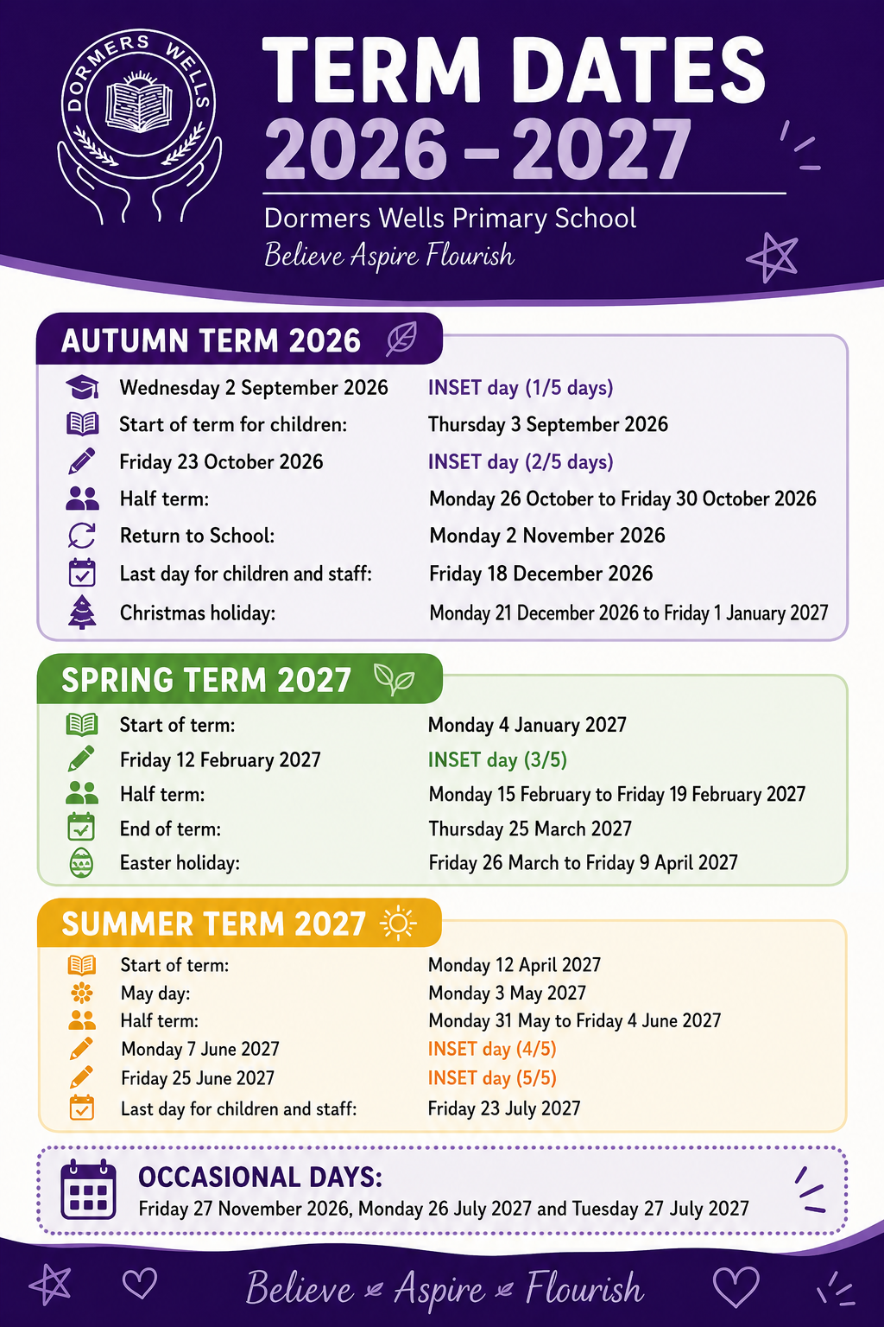
Term dates 2026-2027
Believe Aspire Flourish

Slide 9




The School Day- KS2
Timings
8.40am | School gates and doors to classrooms open – Gate 7 (Gate 8 until further notice)
8.50am | Gates close – late pupils will have to go through the office
9.00am | Lesson 1 begins (Guided Reading)
9.45am | Lesson 2 begins (English)
10.45am | Break (15 minutes)
11.00am | Lesson 3 (Math)
12.00pm | Assembly (Monday Merit/Tuesday Phase/Wednesday singing/Thursday in class/Friday Deputy/ Assistant Head)
12.15pm | Lunch (1 hour)
1.15am | Lesson 4 (Topic)
2.15pm | Lesson 5 (Topic)
3.00pm | Class Reader
3.15pm | Home Time
If you wish your child/children to be collected by other named adults at the end of the day during the school year, please ensure this information is given to your child’s teacher. Please note that teachers will not release your child to adults - other than those named on the list.
They will also not release your child to anyone under the age of 16.
Believe Aspire Flourish

Slide 10
Expectations of pupils attitude and behaviour
Children should be prepared for the school day:
Wearing correct school uniform
School bag with correct equipment pencil/pen/rubber/sharpener/ruler
Correct P.E kit worn – only on the day they have PE.
Water bottle – labelled
Reading Records and reading books
Make sure all belongings are clearly labelled.
We have high expectations of all our pupils and expect school rules and values to be followed at Dormers.
Believe Aspire Flourish

Slide 11

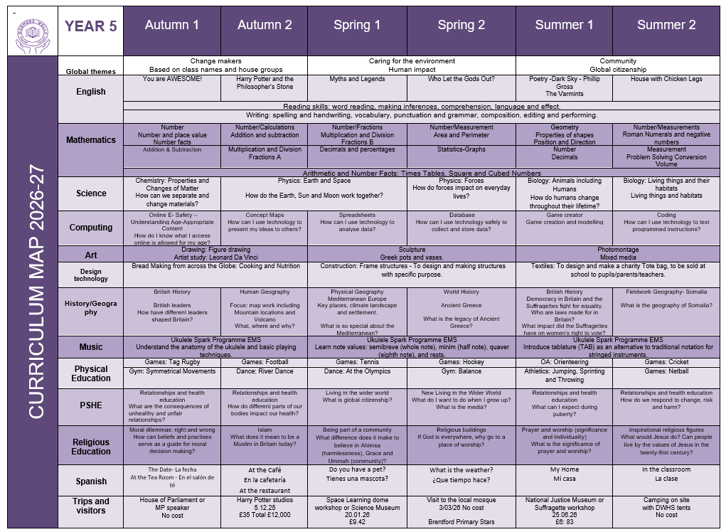
Curriculum Overview
Believe Aspire Flourish

Slide 12





HOMEWORK
Your child is expected to read with an adult/independently for 20 minutes a day, please ask them questions about the text they are reading – which will be included in their Reading Records.
Times Table Rock Star – minimum 3 times a week.
Spelling Shed - Spellings will be tested every week.
Reading Eggs home learning set weekly.
Mathseeds
Century – Maths English and Science
Occasionally, children might be asked to research for a topic/theme or complete a project.
Please keep passwords safe.
Believe Aspire Flourish

Slide 13

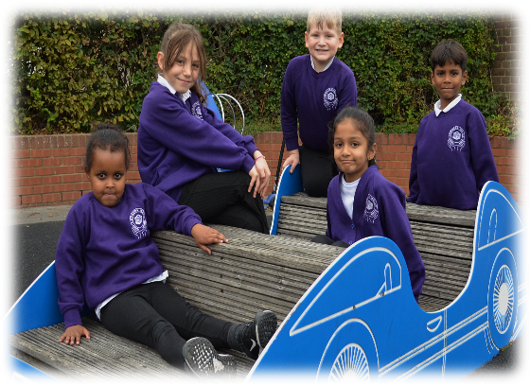
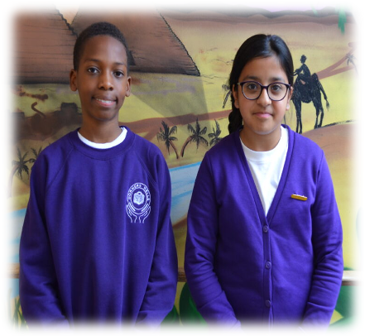

Uniform
Girls
Purple jumper or cardigan with school logo
White polo shirt with or without school logo
Black school skirt, shorts, tunic or trousers
Plain black tights or socks (winter) White socks for girls with summer uniform
Plain black shoes no fancy designs
Black, purple or white hijab (plain)
Religious jewellery is permitted and ear studs, no hoop earrings should be worn
No makeup or nail polish to be worn in school
Girls may wear purple and white checked or striped summer dresses and the school cardigan with white socks or tights. No open- toed sandals
Boys
Purple jumper with school logo
White polo shirt with or without school logo
Black school trousers or shorts - tailored
Plain black shoes
For Sikh children who have uncut hair, coverings should be plain black, white or purple
Religious jewellery only
Ensure you label the clothes
Believe Aspire Flourish

Slide 14

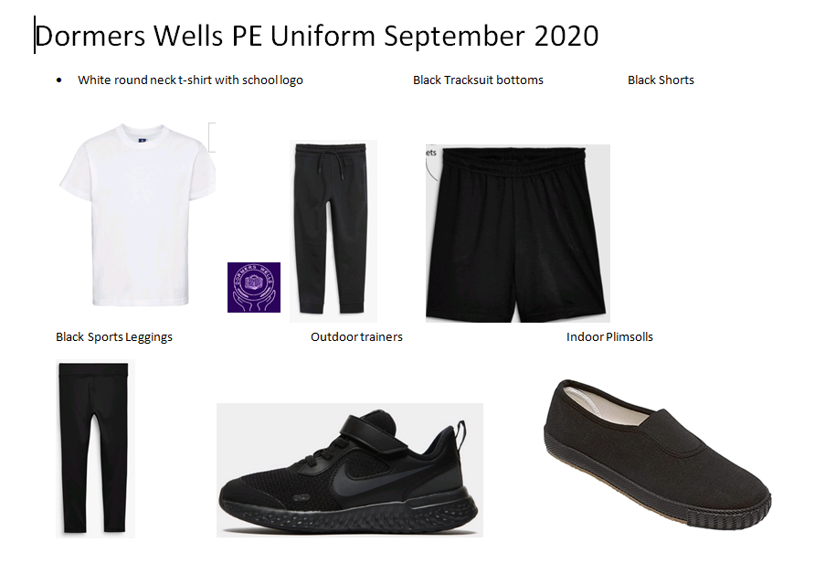
P.E Days and Kit
All children must wear the following as part of their P.E. kit on PE days:
Plain white school T-shirt with logo or without
Plain black shorts
Track suit bottoms may be worn in the winter- they should be plain black
Children need trainers and these should be checked for fit regularly
Ms Kaler's class –Monday and Friday
Ms. Ellington’s class –Wednesday and Friday
Believe Aspire Flourish

Slide 15

School Dinners - Being Healthy
ALL PUPILS are entailed to school meals. We encourage all parents to ensure their children take advantage of the delicious hot meals cooked on site.
Children who have a packed lunch (Nut Free), must bring their lunch to school in a clearly named lunchbox.
We encourage healthy eating and therefore do not allow fizzy drinks or confectionery.
Children should have a balanced meal to include:
a savoury snack, such as a sandwich or pitta bread,
a piece of fruit or yogurt
a healthy drink such as fruit juice, milk or water.
Please do not include nuts, nut products, glass bottles or glass containers.
Believe Aspire Flourish

Slide 16

Water Bottles - Being Healthy
All children should have a plastic/stainless steel water bottle to keep hydrated during the day
Children are encouraged to drink water throughout
the day. They should have a sipper bottle that is
labelled with their name and class.
A sipper bottle will not leak if it tips over and this is
important as bottles are on the children’s desks and this will prevent damage to books and their work.
Believe Aspire Flourish

Slide 17




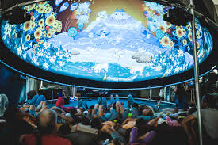
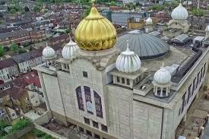
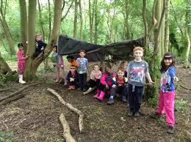
Harry Potter Experience- Cost £30.00 or £35 depending on venue
Space Learning Dome- Cost £9.42
Suffragettes workshop- Cost £6.83
Camping – Free
Local Mosque visit
MP Visit
If the cost of trips is not covered then they will have to be cancelled. The school cannot afford to cover trips. If you need help with a payment plan, please see the office in confidence.
Cash cannot be used to pay for school trips/ Parents must pay through school comms

Slide 18

Parent Safeguarding training
Parent Safeguarding training will start at 9.00am on Monday 14th September, hosted in KS2 hall by the Deputy Head Teacher / Safeguarding Lead.
Parents who have attended in the past are requested to attend again as a new list will be formulated for this academic year 26/27.
Parents attending the training would be allowed to join teachers on trips , excursions or volunteer to help in school as the need arises.
Believe Aspire Flourish

Slide 19
Optional Tests
Usually in May after the year 6 SATs
Timings of tests may change
Monday | SPAG (Spelling, Punctuation and Grammar)
Tuesday | Reading
Wednesday | Mathematics Arithmetic Paper 1 and Reasoning 2
Thursday | Mathematics Reasoning Paper 3
Believe Aspire Flourish

Slide 20
Concerns and Queries
If you have a problem or concern:
1. Make an appointment with your child’s class teacher
2. If your issue remains unresolved make an appointment at the office to talk to the phase leader-
Please make appointments via the office for other concerns:
For SEN issues contact (SENCO)
For safeguarding issues contact: Mrs Cornelius.
Believe Aspire Flourish

Slide 21
Class reps
🌟 Why do we need Class Reps?
Class Reps can help make communication between families and the school easier.
They can:
📢 Share information — pass on useful reminders, dates and announcements from the school or class teacher.
💬 Help parents communicate — give parents/carers a friendly point of contact if they have general questions or suggestions.
🤝 Build a stronger class community — help families get to know one another and feel more connected.
💡 Collect ideas and feedback — bring constructive suggestions from parents to the appropriate person at school.
🎉 Support class activities — where appropriate, help organise social activities or support school events.
🌈 Make new families feel welcome — particularly families who have recently joined the school.

Slide 22
The Class Rep will:
Create or join the agreed parent/carer communication group.
Share information provided by the school or PTA/Friends of the School.
Encourage parents to take part in school activities and community events.
Listen to general suggestions or ideas from parents.
Pass appropriate feedback to the teacher, PTA or school.
Help welcome new parents and families to the class.
Work alongside other Class Reps to share ideas and organise occasional activities.
What isn't the Class Rep's role?
This is important so that parents understand the role isn't a burden.
A Class Rep wouldn't be expected to:
Deal with complaints about individual children, teachers or staff.
Discuss confidential or sensitive matters.
Act as a spokesperson in disputes.
Answer questions about school policies or decisions on behalf of the school.
Be available 24/7.
Organise lots of events or spend their own money.
For individual concerns, parents should continue to contact the school or teacher through the normal channels.

Slide 23
What are the benefits?
Being a Class Rep can be a great way to:
Meet other parents and make new friends.
Become more involved in your child's school community.
Help create a welcoming and supportive environment.
Have a constructive way to share ideas and feedback.
Help parents who may otherwise feel disconnected from school life.
Develop useful communication, organisation and teamwork skills.
Make a positive difference to the experience of children and families.
Please see Mrs Cornelius at the end of this meeting.

Slide 24

Communication with teachers
Any school events and activities will be on ClassDojo, so please ensure that you are checking updates and messages.
Teachers may message parents/carers if they too have any concerns.
In order to speak to/contact the teacher, please send them a message on ClassDojo with your concerns.
If you have not already signed up, please tell your children to tell their teacher, who will provide you with the details on how to join.
N.B. Teachers will not reply after 5pm or weekends unless in an emergency.

Slide 25

Before you leave, please sign our Home school agreement
(content has not changed, just more visual)
Believe Aspire Flourish

