Slide 1

Register
Please sign the register as you arrive.
Please write your child’s name and then sign.
THANK YOU!

Slide 2

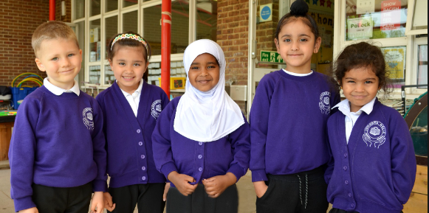
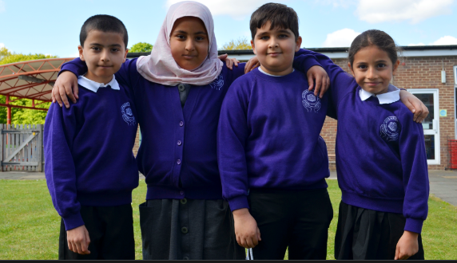
DORMERS WELLS
PRIMARY SCHOOL
Diversity- Opportunity –Resilience- Memorable Empathy- Respect –Success
Believe Aspire Flourish

Slide 3


Slide 4

DORMERS WELLS
PRIMARY SCHOOL
Background information
The junior and infant school became a primary school in September 2023.
We are now a through primary school from Nursery to Year 6.
Most recently, the school achieved a GOOD with OUTSTANDING elements as an ofsted Rating.

Slide 5
DORMERS WELLS
PRIMARY SCHOOL
Staff
Head teacher- Mrs George
Deputy head- Mrs Mosley
Assistant head (inclusion/SENDCO) – Mrs Sargeant
Assistant Head (Assessment) – Mr Cotton
Office Manager - Ms Doyle
Welfare and Attendance - Miss Scott

Slide 6
DORMERS WELLS
PRIMARY SCHOOL
Year 1 Staff
Phase Leader KS1 – Miss Forrester
Year 1 Teacher & Year 1 Lead Miss Moreno (1E Earhart)
Year 1 Teacher Miss Baraky (1S Seacole)
Teaching assistants/support staff:
Mrs Plaha (Earhart) and Mrs Joshi (Seacole)

Slide 7


Our School Priorities 2026- 27
Believe Aspire Flourish

Slide 8
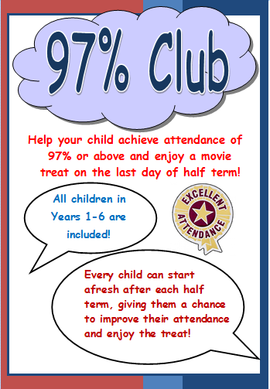
DORMERS WELLS
PRIMARY SCHOOL
Attendance and Medication
If your child has any medication that is needed in school eg asthma pumps, epi pens etc, please ensure it is up to date and present in school.
Attendance is vital!
Ideally children should be here every day. If you know your child is going to be away, you should inform the office before the day of absence.
If your child is ill, please ensure you ring the office on the morning they are absent other wise this will be an ‘unauthorised absence’. We monitor attendance very closely alongside Ealing borough. Frequent absences will lead to further intervention and this may include meeting with the head/deputy head or the Ealing School Warden.

Slide 9
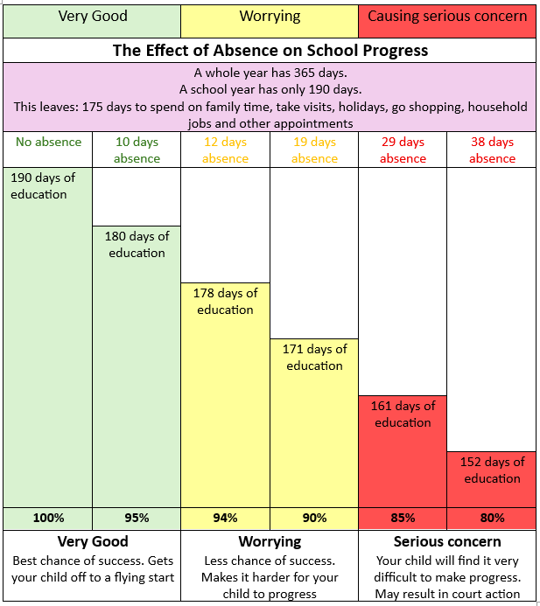
Attendance and Medication
Across one school year:
Less than 5 days absence = 97.3% attendance
14 days absence (approx.) = 92.6% attendance
20 days absence (approx.) = 89.4% attendance
30 days absence (approx.) = 84.2% attendance
If a child achieves 80% attendance this means that they have missed approximately 39 days of education over the academic year, averaging 1 day per week.

Slide 10
DORMERS WELLS
PRIMARY SCHOOL
Holiday request
We work within the government guidelines and with Ealing borough to monitor attendance.
We are not permitted to grant holiday leave unless in extreme circumstances and this must be agreed by the head or deputy head teacher. Term time holidays will not be granted.
There are 13 weeks of holiday built into the school year and this is time for family holidays. Missing school for a period of time may result in your child being taken off roll-losing their place!

Slide 11
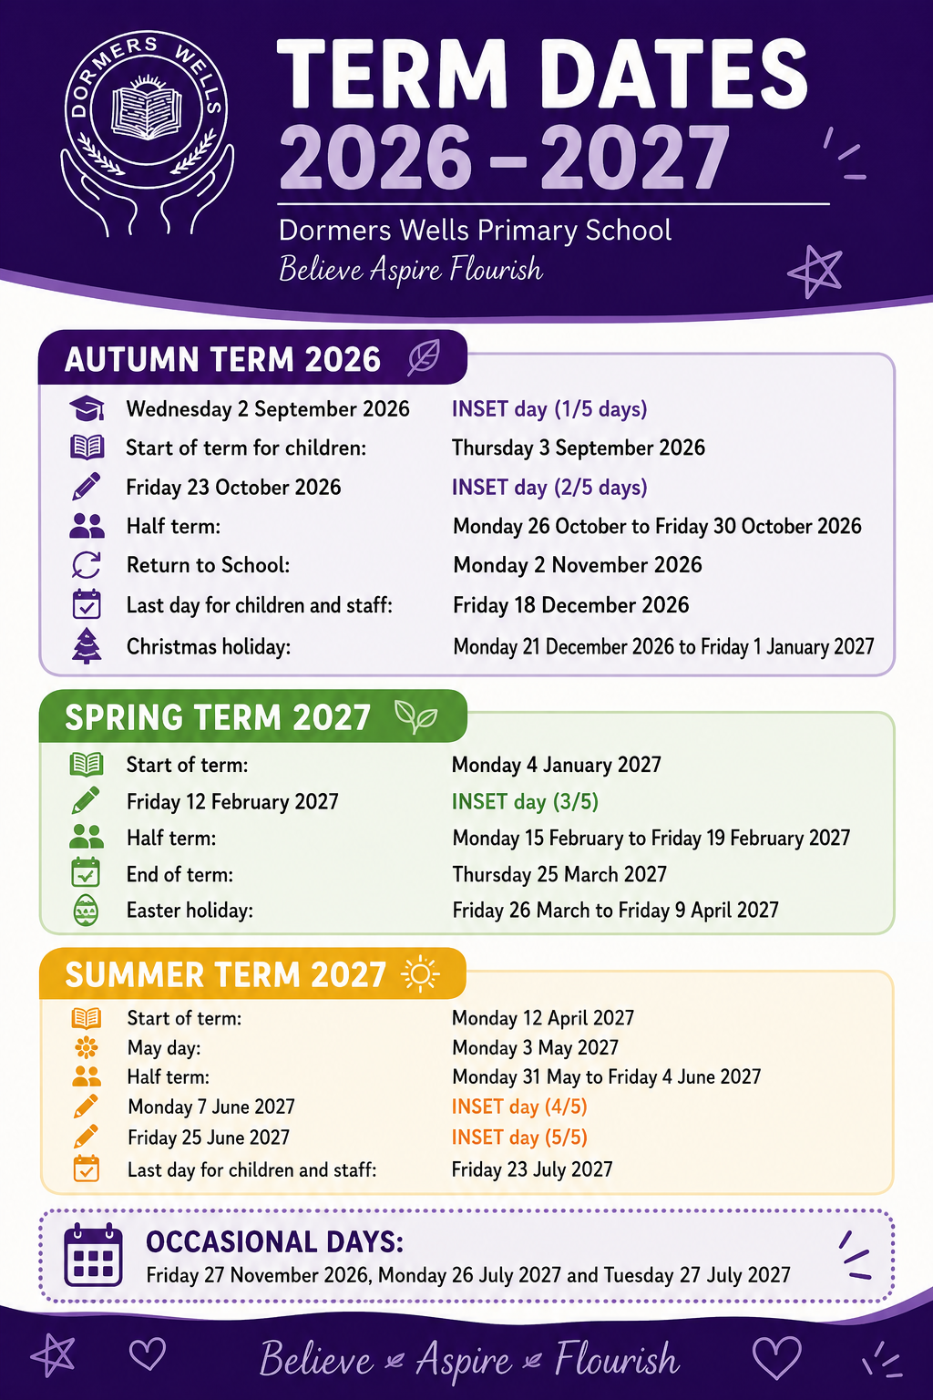
Term dates 2026-2027

Slide 12
DORMERS WELLS
PRIMARY SCHOOL
The School Day
Gates open at 8:40am for Year 1 children to begin the day.
The children then start the day with a ‘Soft Start’ beginning at 8.45am with reading. Lessons commence at 9:00am and gates are shut promptly. If your child arrives after this time you will need to take them to the main office (infant entrance
The end of day is at 3.15pm. Year 1 children are collected from the infant playground. After 3.25pm they should be collected from the main reception.
If you wish your child/children to be collected by other named adults at the end of the day during the school year, please ensure this information is given to your child’s teacher. Please note that teachers will not release your child to adults - other than those named on the list.

Slide 13
An average day in Year 1
Soft Start – Reading
Phonics
Reading Groups –Monday, Tuesday, Wednesday
English
Break time
Maths
Lunch
Handwriting
Foundation subjects
Assembly
Story

Slide 14
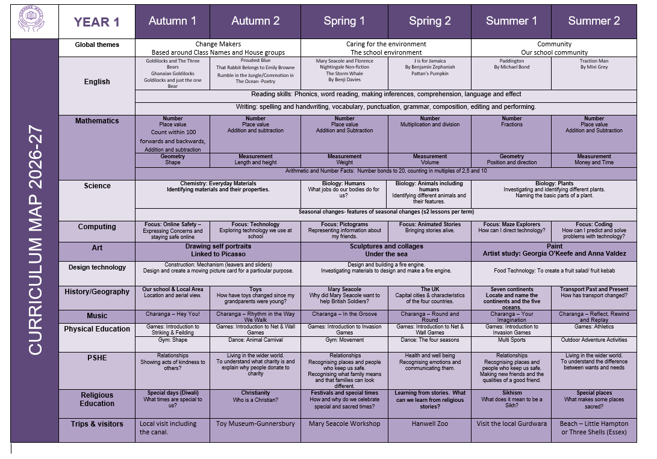
Curriculum Overview

Slide 15
Trips
Autumn 1 – Local Walk to Three Bridges and the Grand Union Canal
Autumn 2 – Gunnersbury Park Museum, Toy Workshop
Spring 1 – Mary Seacole Workshop (In school)
Spring 2 – Hanwell Zoo
Summer 1 – Local visit to Gurdwara
Summer 2 – Beach Trip (Little Hampton or Three Shells, Essex)
Payment for these trips will be made available on our School Gateway app.

Slide 16


Trips and visits
If the cost of trips is not covered then they will have to be cancelled. The school cannot afford to cover trips. If you need help with a payment plan, please see the office in confidence.
If you can support us with trips, you must attend the Safeguarding training with Mrs Cornelius on Monday 14th September at 9am. Only those who have attended can accompany on trips.
Believe Aspire Flourish

Slide 17
Home Learning
English: Reading daily minimum of 10-15 minutes each day using Big Cat Phonics book linked to our Little Wandle Phonics Scheme or any library books.
Spelling/Phonics 1x a week (given out on Friday and tested the following Friday.)
Maths: Numbots Games and Activities. Please see children’s reading record for log in details.
https://play.numbots.com/#/account/school-login/30497

Slide 18

Phonics/Reading
Year 1 will be revising the Phonic sounds
children were taught in Reception.
Little Wandle is the phonics programme used by the school.
Parents are encouraged to and can visit the website for more information. https://www.littlewandlelettersandsounds.org.uk/resources/for-parents/
Your child will bring two reading books home:
One decodable book and one book for enjoyment, loaned from the school/class library.
Your child should read for a minimum of 10 minutes each day.
A fee will be charged for lost or damaged books.
Your child should bring their reading books to school EVERY DAY.

Slide 19
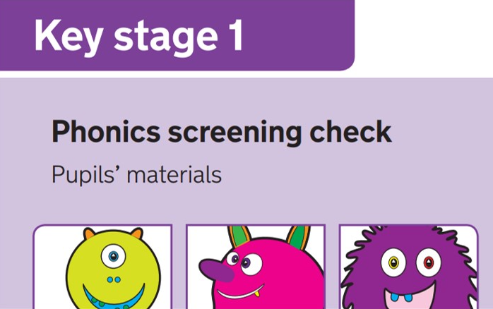
Phonics Screening
ALL children in Year 1 will be tested on their phonic knowledge at the end of the Year.
The phonics screening test usually takes place in June.
Further information about specific dates and the test itself will be given later in the year.

Slide 20
DORMERS WELLS
PRIMARY SCHOOL
Expectations of pupils attitude and behaviour
Children should be prepared for the school day.
Learning behaviour
School bag
Water Bottle
Packed lunch (if you are providing from home)
Home learning and reading books
Notes:
JM

Slide 21
DORMERS WELLS
PRIMARY SCHOOL
Uniform
Girls
Purple pullover or cardigan with school logo
White polo shirt with or without school logo
Grey or black school skirt, tunic or trousers
Plain grey or navy blue tights or socks (winter) White socks or tights for girls with summer uniform
Plain black shoes or boots (no heel)- no fancy designs
Black, purple or white hijab (plain)
Religious jewellery is permitted and ear studs, not hoop earrings should be worn
No makeup or nail polish to be worn in school.
Girls may wear purple and white checked or striped summer dresses and the school cardigan with white socks or tights. No open- toed sandals

Slide 22
DORMERS WELLS
PRIMARY SCHOOL
Uniform
Boys
Purple pullover with school logo
White polo shirt with or without school logo
Grey or black school trousers
Plain black shoes
No mohawk style haircuts or haircuts with carved features
For Sikh children who have uncut hair, coverings should be black or navy blue
Religious jewellery only

Slide 23
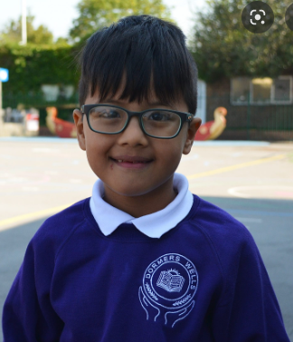
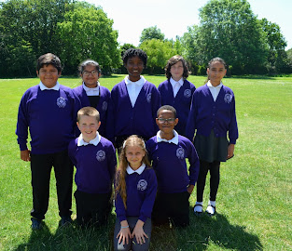

Slide 24
DORMERS WELLS
PRIMARY SCHOOL
P.E
All children must have the following as part of their P.E. kit:
School T-shirt with logo and plain navy, black or purple shorts in school PE bag
Track suit bottoms may be worn in the winter- they should be plain navy or black
Children need plimsolls and trainers and these should be checked for fit regularly
School uniform is available for purchase from Fashion Mark, 18 High Street, Southall, UB1 3DA

Slide 25
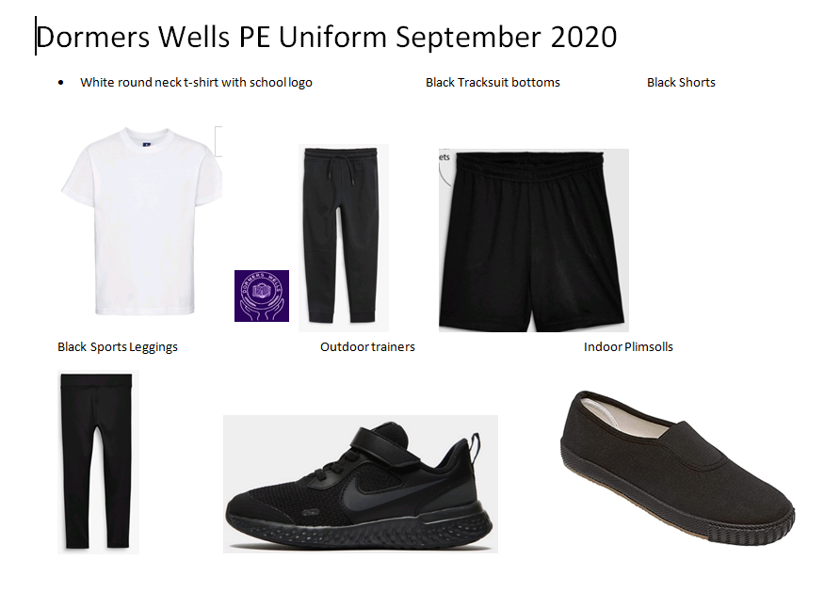

Slide 26
P.E Days
Seacole (Miss Baraky) – Monday & Tuesday
Earhart (Miss Moreno) – Monday & Tuesday
Please ensure your child comes to school in their P.E kits on these days.

Slide 27

DORMERS WELLS
PRIMARY SCHOOL
Being Healthy
All children should have a plastic water bottle to keep hydrated during the day
Children who have a packed lunch, must bring their lunch to school in a clearly named lunchbox.
We encourage healthy eating and therefore do not allow fizzy drinks or confectionery.
Children should have a balanced meal to include:
a savoury snack, such as a sandwich or pitta bread,
a piece of fruit or yogurt
a healthy drink such as fruit juice, milk or water.
Please do not include nuts, nut products, glass bottles or glass containers.

Slide 28

DORMERS WELLS
PRIMARY SCHOOL
Water bottles
Children are encouraged to drink water throughout
the day. They should have a sipper bottle that is
labelled with their name and class.
Water bottles should not be put into book bags.
A sipper bottle will not leak if it tips over and this is
important as bottles are sometimes on the children’s desks and this will prevent damage to books and their work.

Slide 29
DORMERS WELLS
PRIMARY SCHOOL
Concerns and Queries
If you have a problem or concern
1. Class Teacher
2. Phase Leader
3. Head or Deputy Head
Please make appointments via the office for other concerns:
For SEN issues contact Ms Sargeant (SENCO)
For safeguarding issues contact Mrs George and Mrs Mosley.

Slide 30

Parent volunteers
If you can consistency give some time each week to be a parent reader, please email or come into the school office to ask for an application. We would love to have you!

Slide 31
Class reps
🌟 Why do we need Class Reps?
Class Reps can help make communication between families and the school easier.
They can:
📢 Share information — pass on useful reminders, dates and announcements from the school or class teacher.
💬 Help parents communicate — give parents/carers a friendly point of contact if they have general questions or suggestions.
🤝 Build a stronger class community — help families get to know one another and feel more connected.
💡 Collect ideas and feedback — bring constructive suggestions from parents to the appropriate person at school.
🎉 Support class activities — where appropriate, help organise social activities or support school events.
🌈 Make new families feel welcome — particularly families who have recently joined the school.

Slide 32
The Class Rep will:
Create or join the agreed parent/carer communication group.
Share information provided by the school or PTA/Friends of the School.
Encourage parents to take part in school activities and community events.
Listen to general suggestions or ideas from parents.
Pass appropriate feedback to the teacher, PTA or school.
Help welcome new parents and families to the class.
Work alongside other Class Reps to share ideas and organise occasional activities.
What isn't the Class Rep's role?
This is important so that parents understand the role isn't a burden.
A Class Rep wouldn't be expected to:
Deal with complaints about individual children, teachers or staff.
Discuss confidential or sensitive matters.
Act as a spokesperson in disputes.
Answer questions about school policies or decisions on behalf of the school.
Be available 24/7.
Organise lots of events or spend their own money.
For individual concerns, parents should continue to contact the school or teacher through the normal channels.

Slide 33
What are the benefits?
Being a Class Rep can be a great way to:
Meet other parents and make new friends.
Become more involved in your child's school community.
Help create a welcoming and supportive environment.
Have a constructive way to share ideas and feedback.
Help parents who may otherwise feel disconnected from school life.
Develop useful communication, organisation and teamwork skills.
Make a positive difference to the experience of children and families.
Please see Mrs Cornelius at the end of this meeting.

Slide 34
Any questions?

